Slide 1
NVMe Specifications
Nilkantha Bhattacharjee
Intern, SWT - CVF
04/05/2022

Slide 2
Agenda
SGL (Scatter Gather List)
SGL Descriptors
Meta Data
Completion Queue Entry
Status Field

Slide 3
SGL (Scatter Gather List)

Slide 4
SGL
It is a data structure in Memory Address space that describes the data buffer.
That data buffer can be Source or Destination.
It contains one or more SGL Segments.

Slide 5
SGL Segments
Contains one or more Segment Descriptors.
One segment should be physically Contiguous.
One Segment can point to some of the data, all of the data or none of the data or next SGL Segment.

Slide 6
SGL Descriptors
SGL Data Block Descriptors.
SGL Bit Bucket Descriptors.
SGL Segment Descriptors.
SGL last Segment Descriptors.

Slide 7
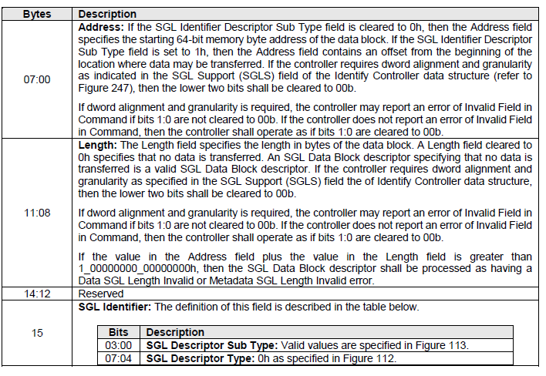
SGL Data Block Descriptors

Slide 8
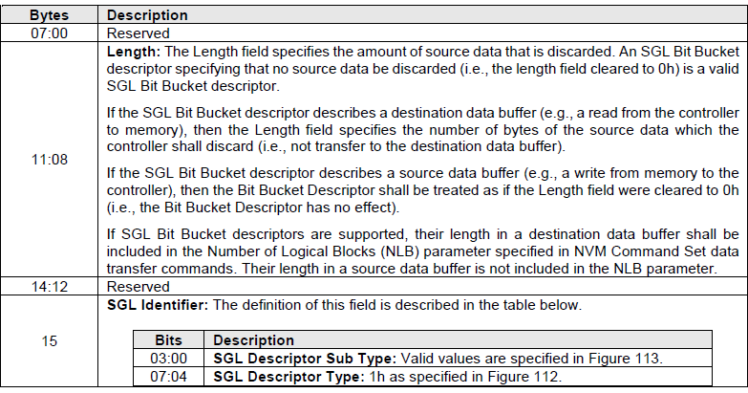
SGL Bit Bucket Descriptors

Slide 9
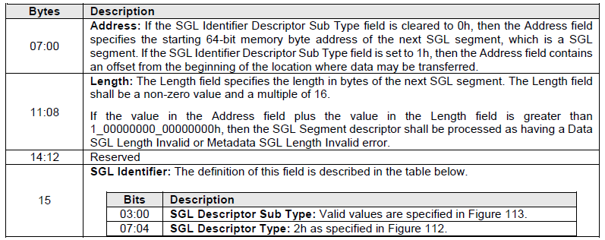
SGL Segment Descriptors

Slide 10
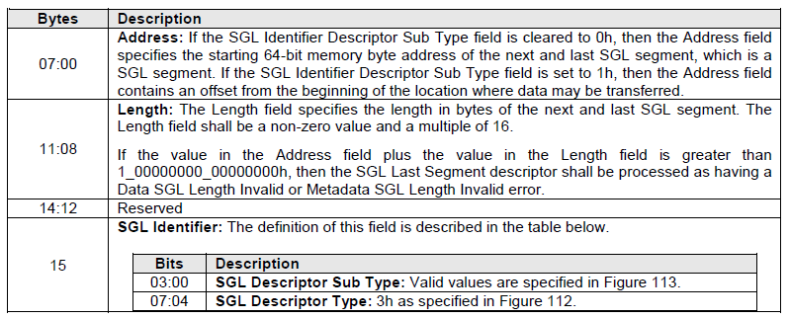
SGL Last Segment Descriptors

Slide 11
Segments
8KB
Data Block Descriptor
Data Block Descriptor
Data Block Descriptor
8KB
Last Segment Descriptor
Data Block Descriptor
8KB
SQE
8KB

Slide 12
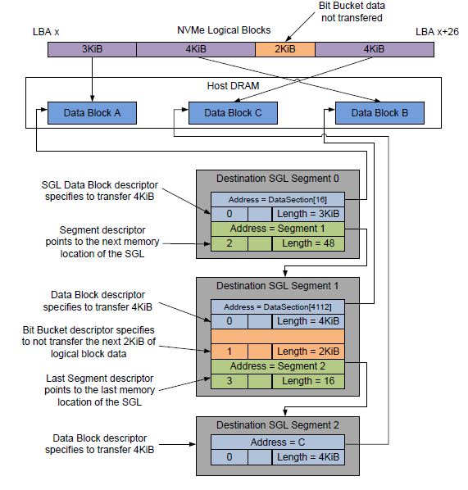

Slide 13
Meta Data
Data about the data.
To provide an additional information about the data.
Mata data is associated with each LBA.
It can be transferred as a separate buffer or as a same buffer.

Slide 14

Completion Queue Entry

Slide 15
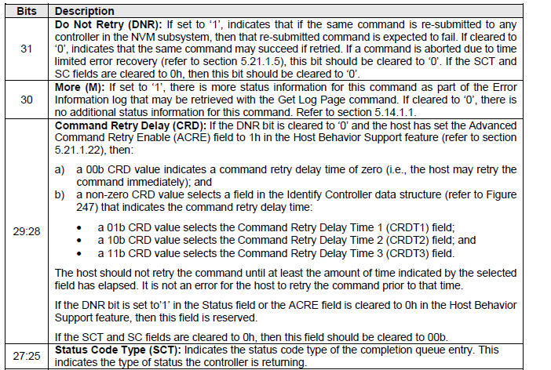
Status Field
The Status Field defines the status for the command indicated in the completion queue entry.

